Slide 1
William Hewitt -- Deere and Company
William Hewitt -- Deere and Company

Slide 4
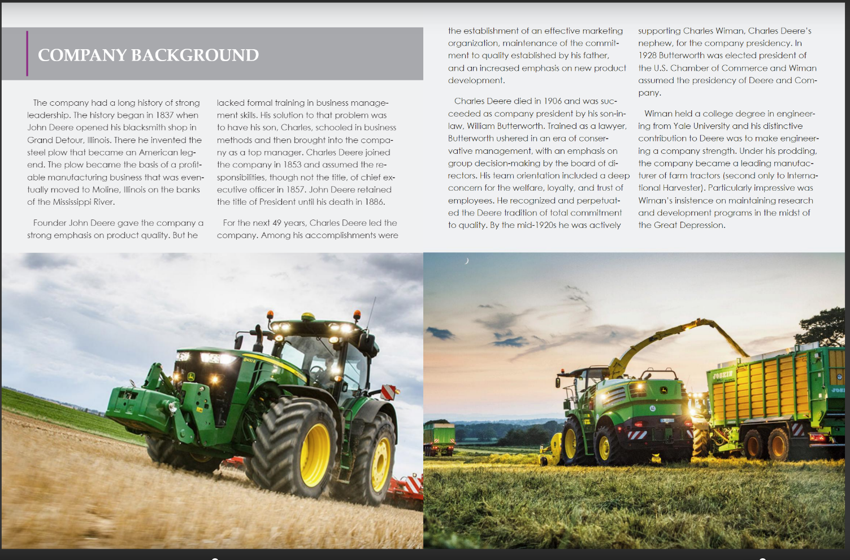

Slide 5
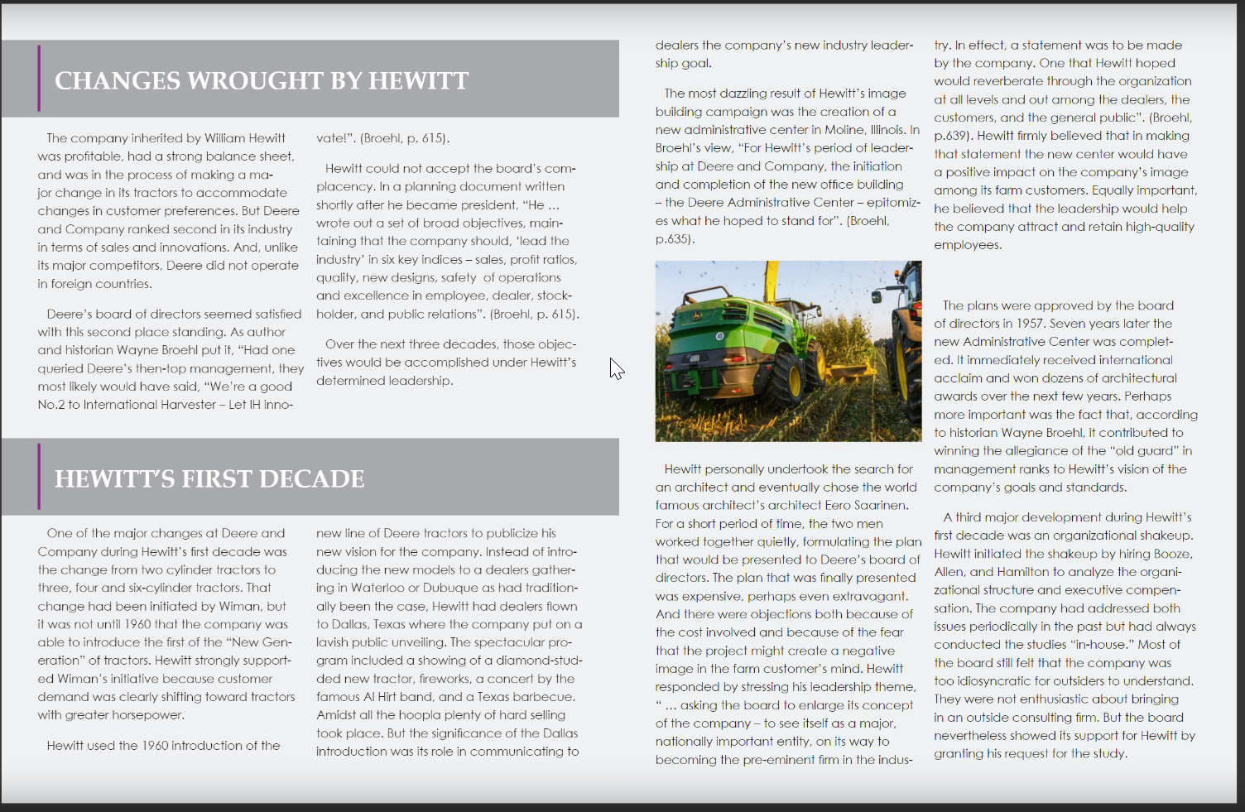

Slide 6
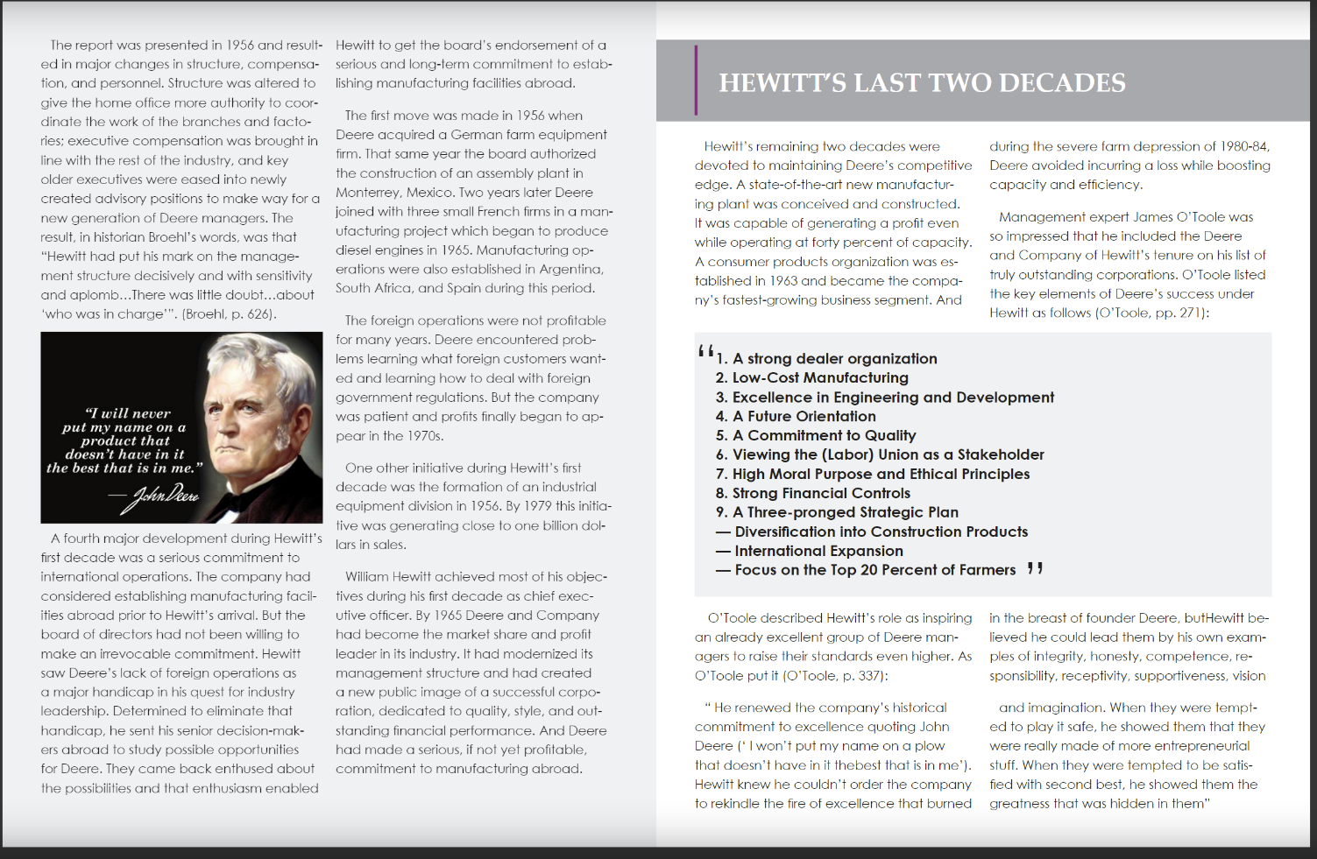

Slide 7
