Slide 1
Wesley H. Loomis III -- General Telephone Directory Company
Wesley H. Loomis III -- General Telephone Directory Company

Slide 4
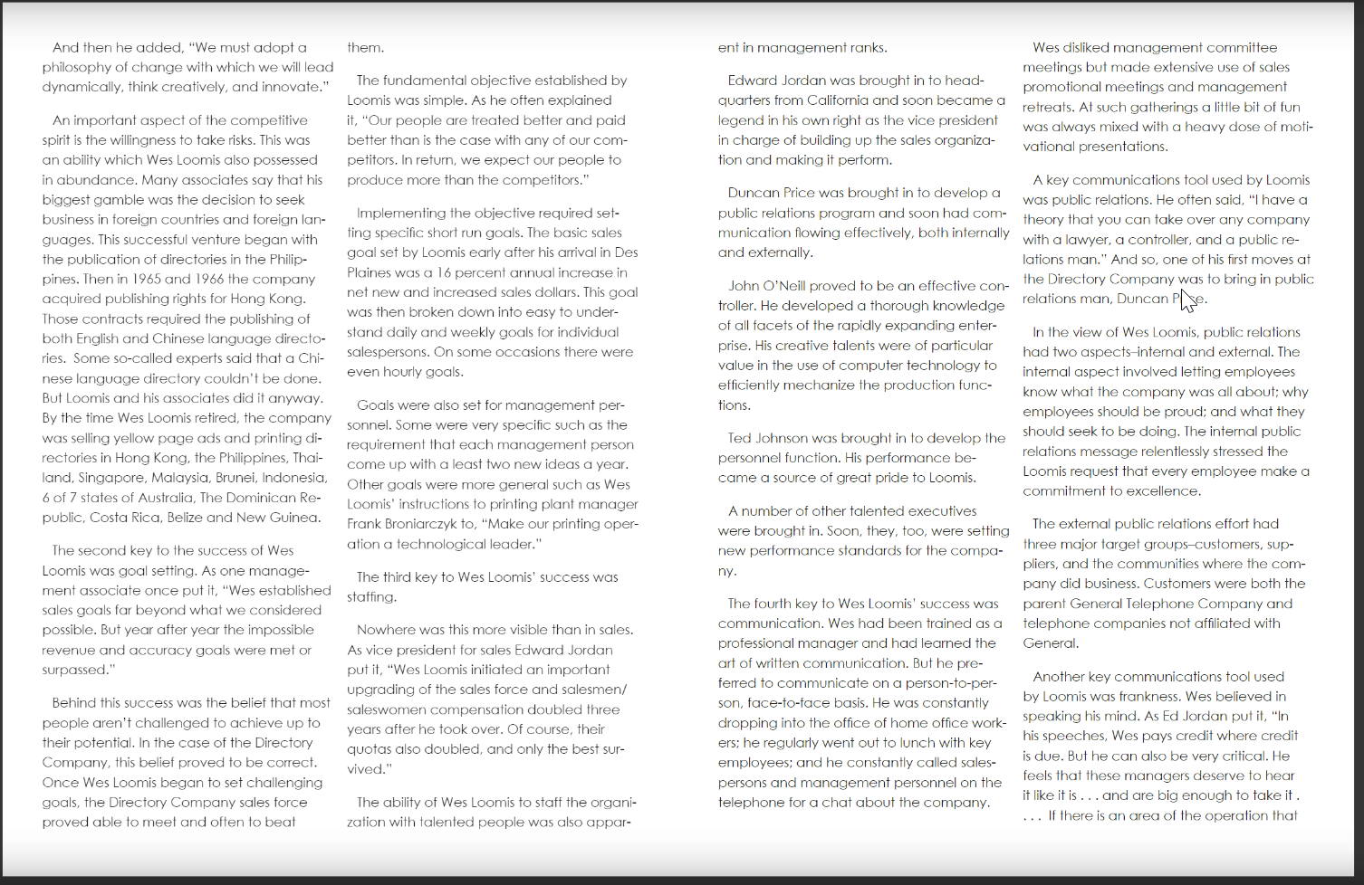

Slide 5
