Slide 1
Tom Roberts Sr. -- Dekalb Ag Research, Inc.
Tom Roberts Sr. -- Dekalb Ag Research, Inc.

Slide 2
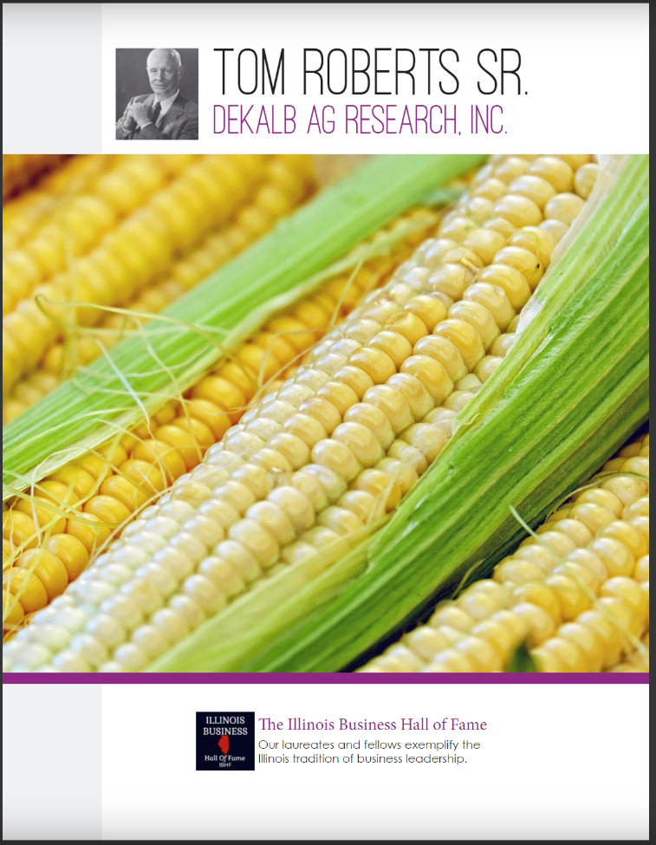

Slide 4
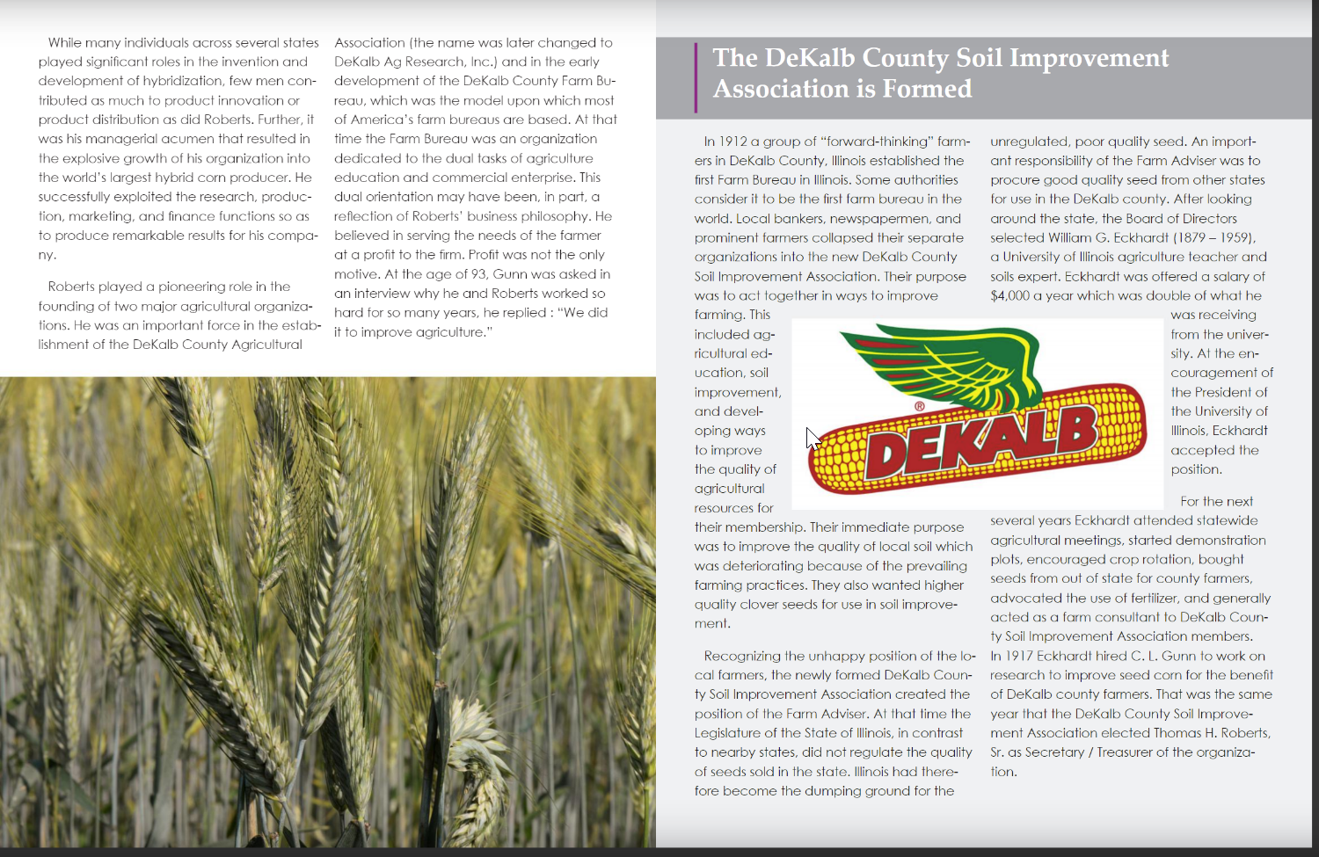

Slide 7
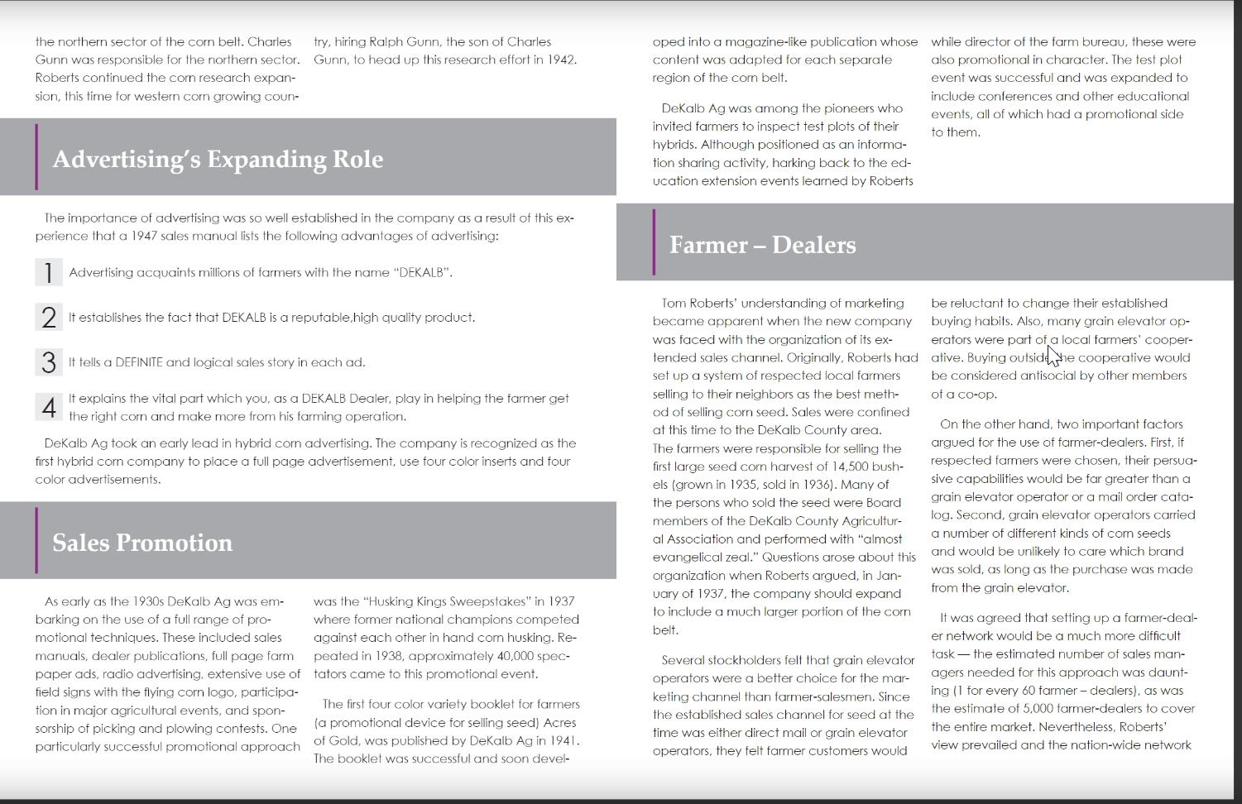

Slide 9
