Slide 1
General Robert Wood -- Montgomery Ward & Company, Sears, Allstate
General Robert Wood -- Montgomery Ward & Company, Sears, Allstate

Slide 3
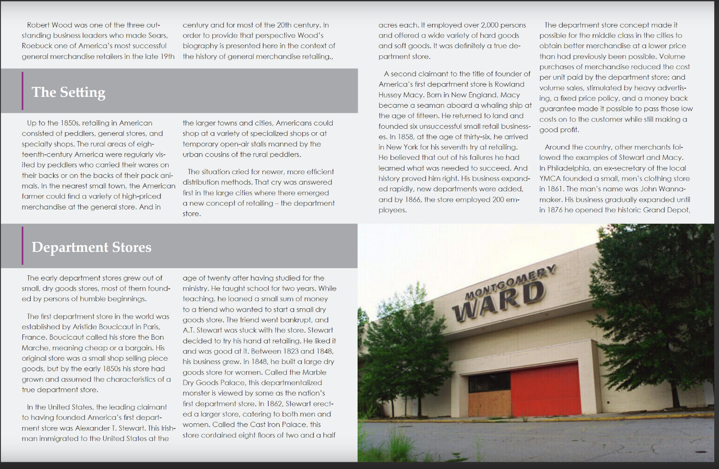

Slide 5
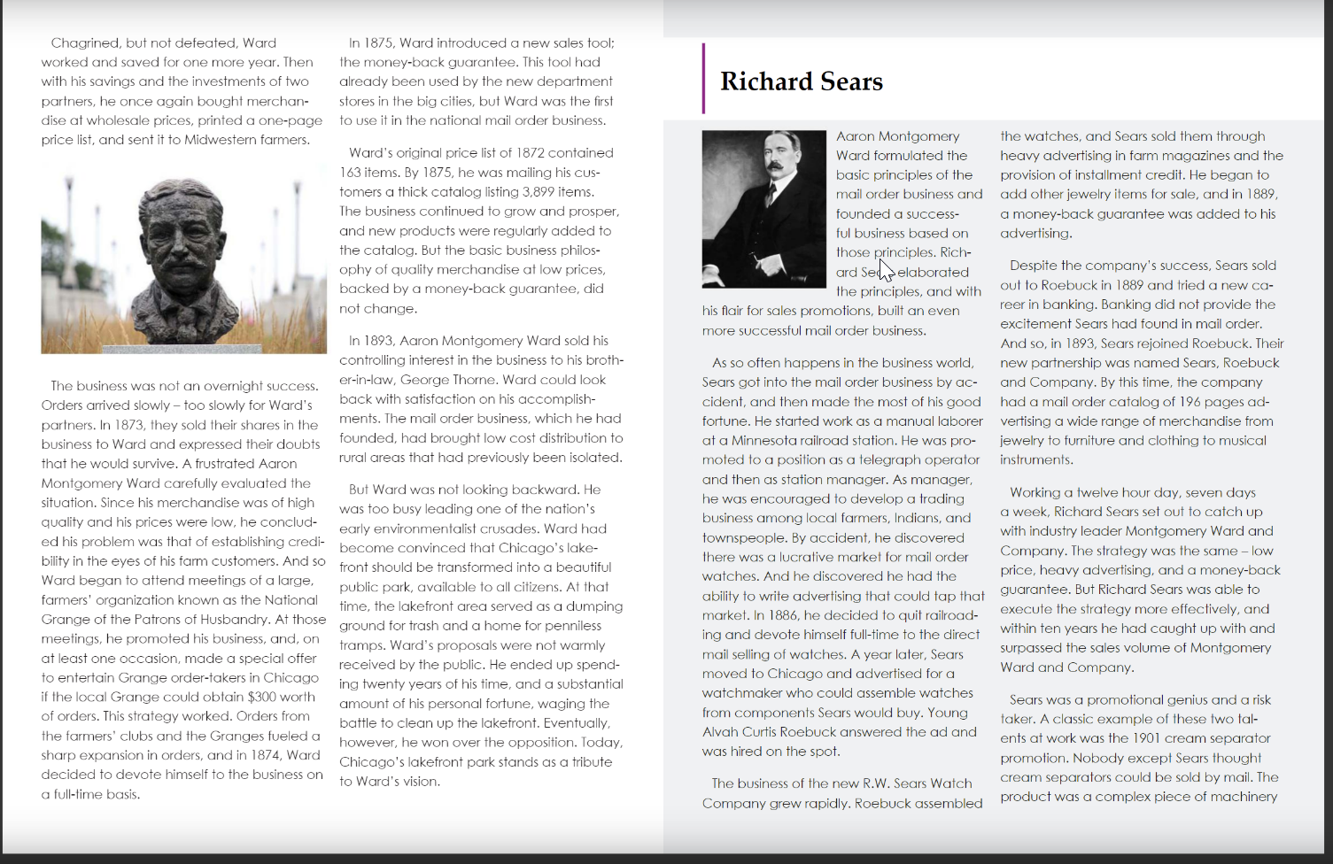

Slide 8
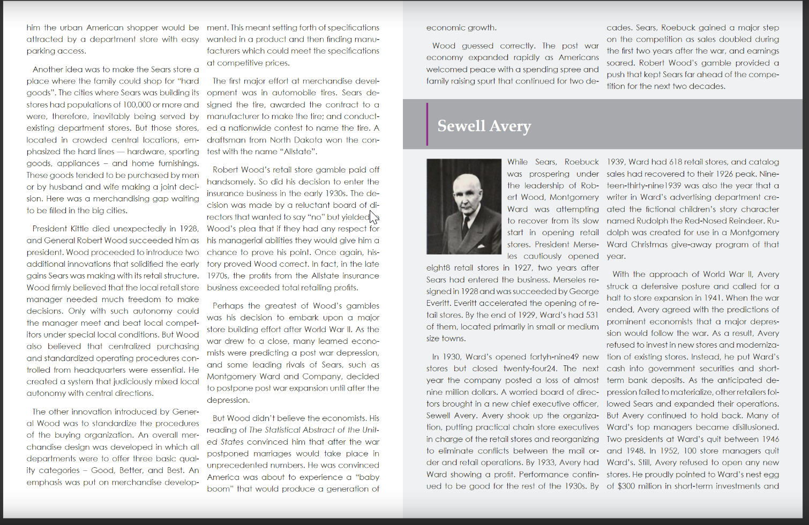

Slide 9
