Slide 1
R.J. FRISBY -- R.J. Frisby Manufacturing Company
R.J. FRISBY -- R.J. Frisby Manufacturing Company

Slide 7
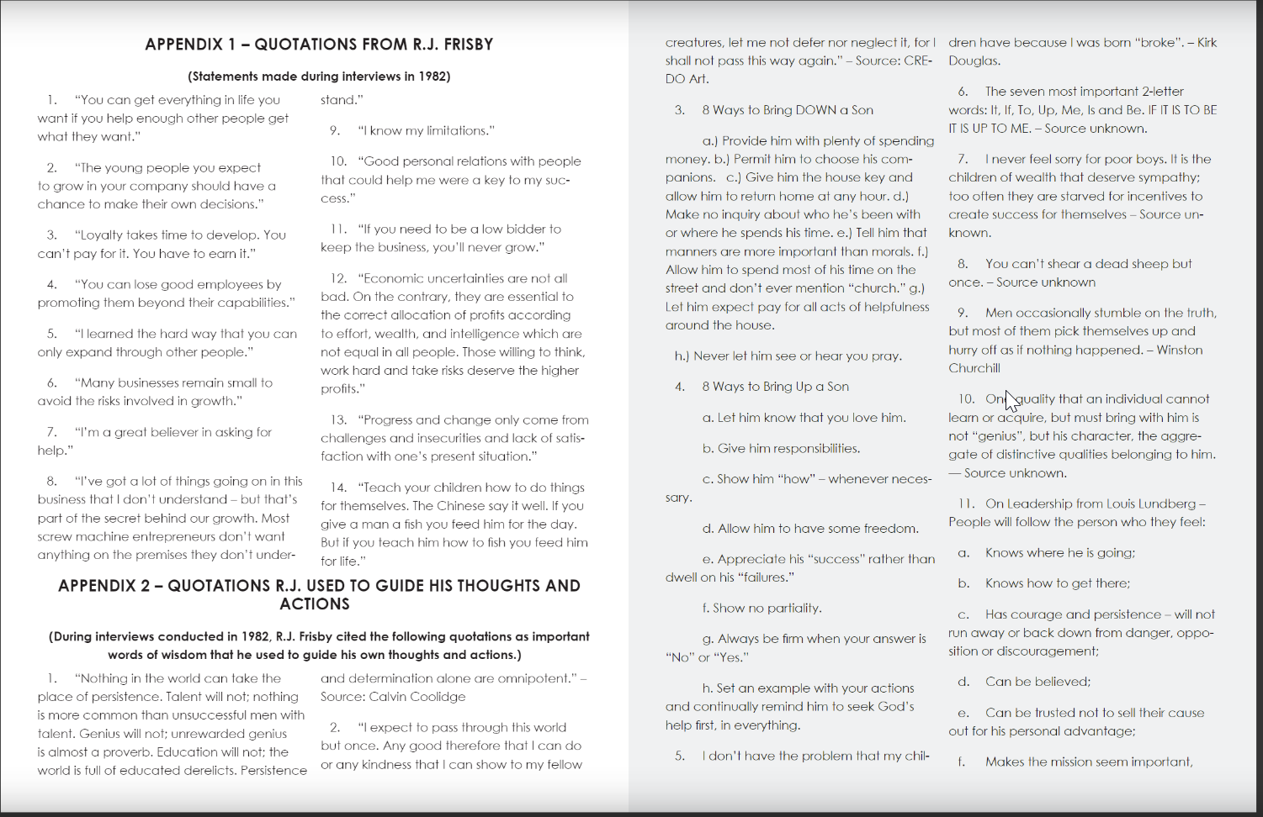

Slide 8
