Slide 1
Ken Wessner -- Servicemaster
Ken Wessner -- Servicemaster

Slide 4
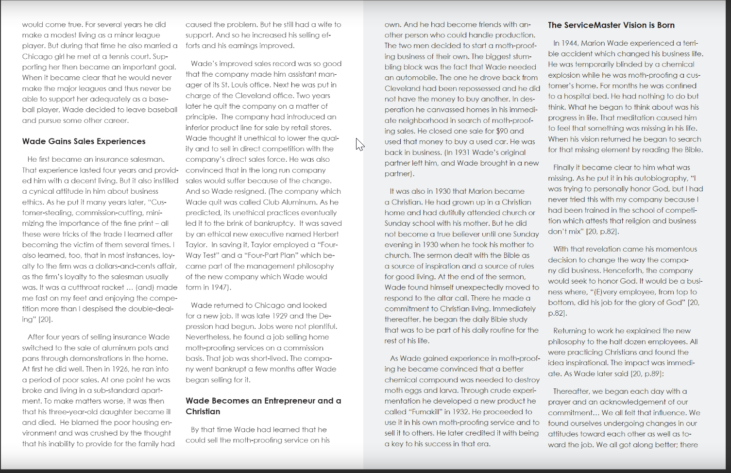

Slide 5
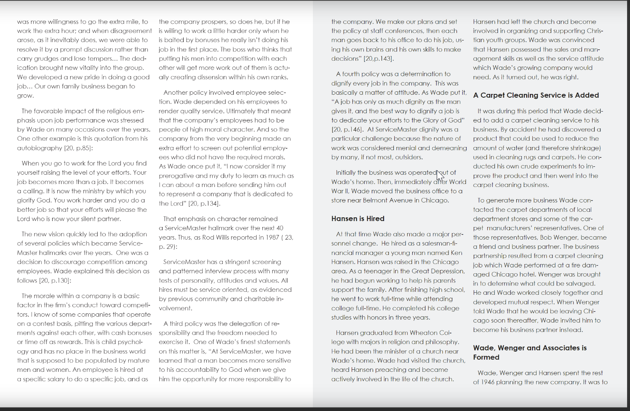

Slide 6
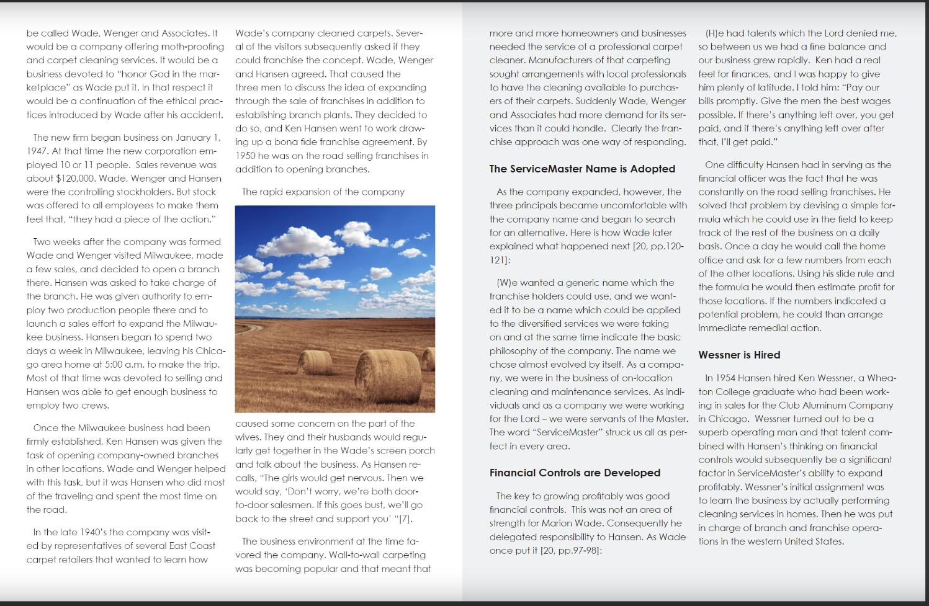

Slide 9
