Slide 1
John Johnson -- Johnson Publishing Company
John Johnson -- Johnson Publishing Company

Slide 3
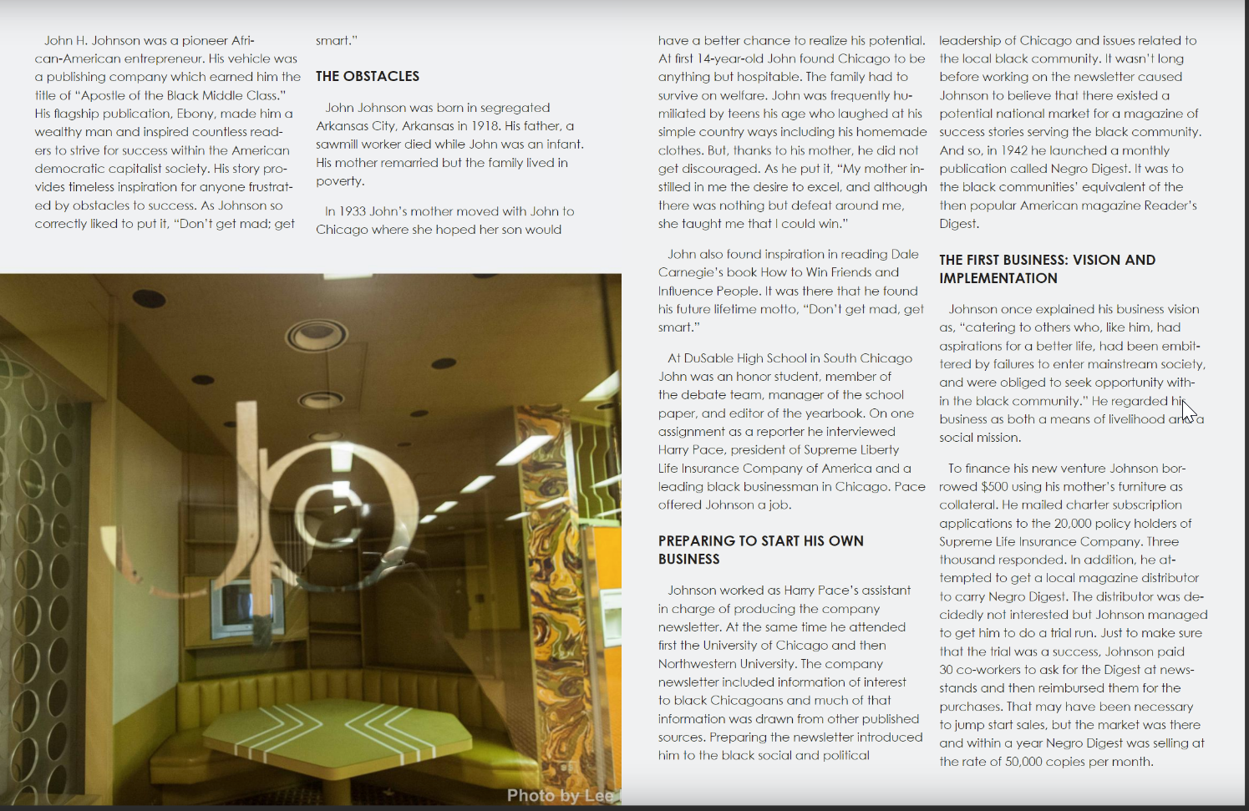

Slide 4
