Slide 1
Irl C. Martin & Woodward Governor -- Woodward
Irl C. Martin & Woodward Governor -- Woodward

Slide 3
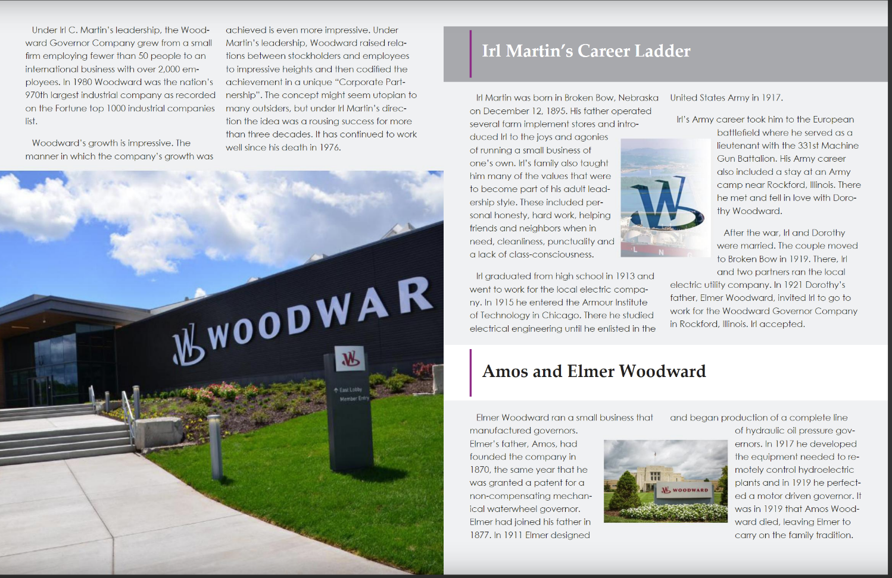

Slide 4
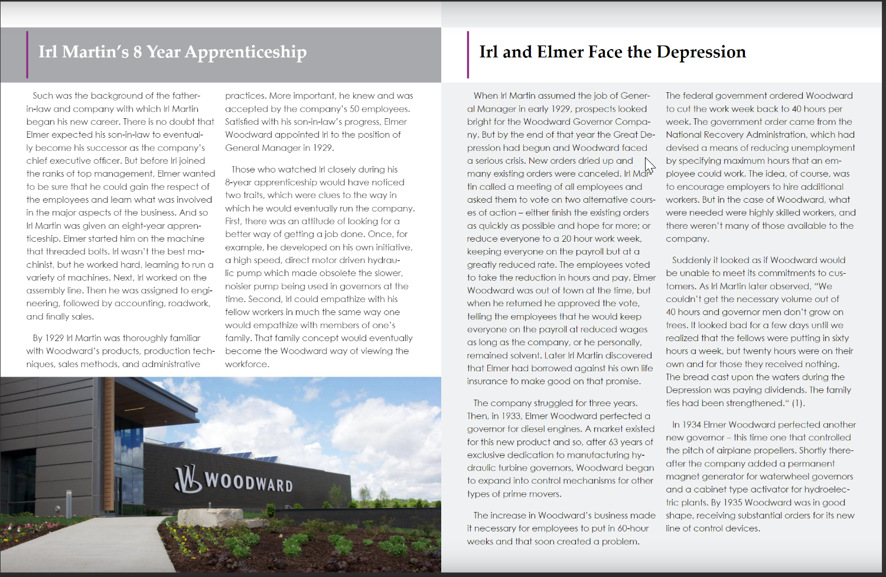

Slide 6
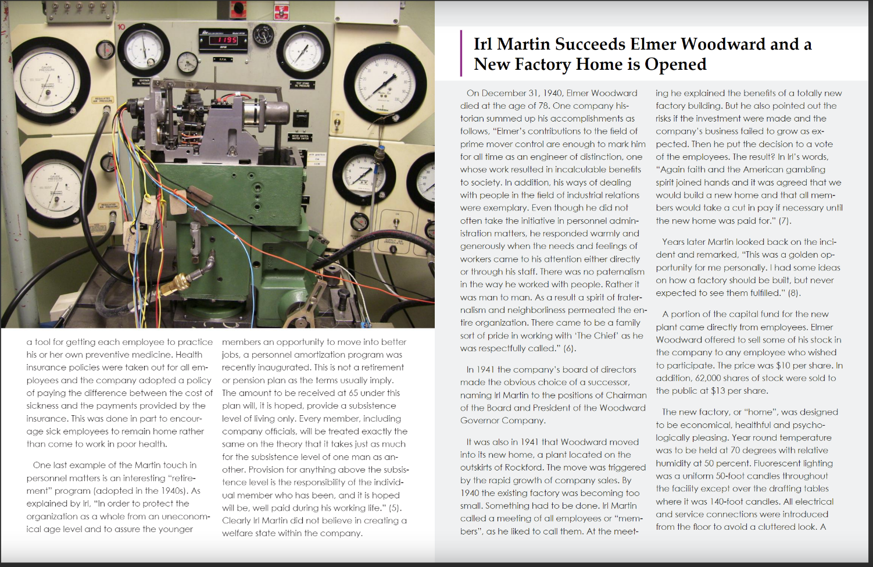

Slide 8
