Slide 1
Charles Walgreen -- Walgreen Co.
Charles Walgreen -- Walgreen Co.

Slide 3
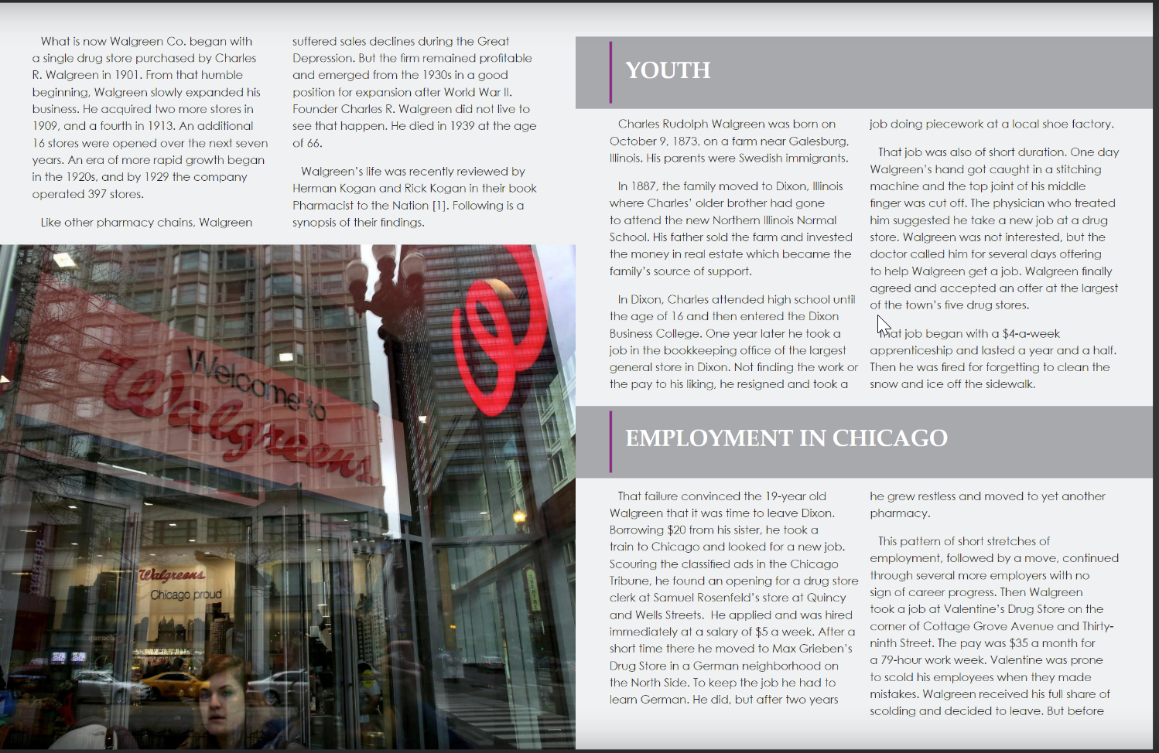

Slide 4
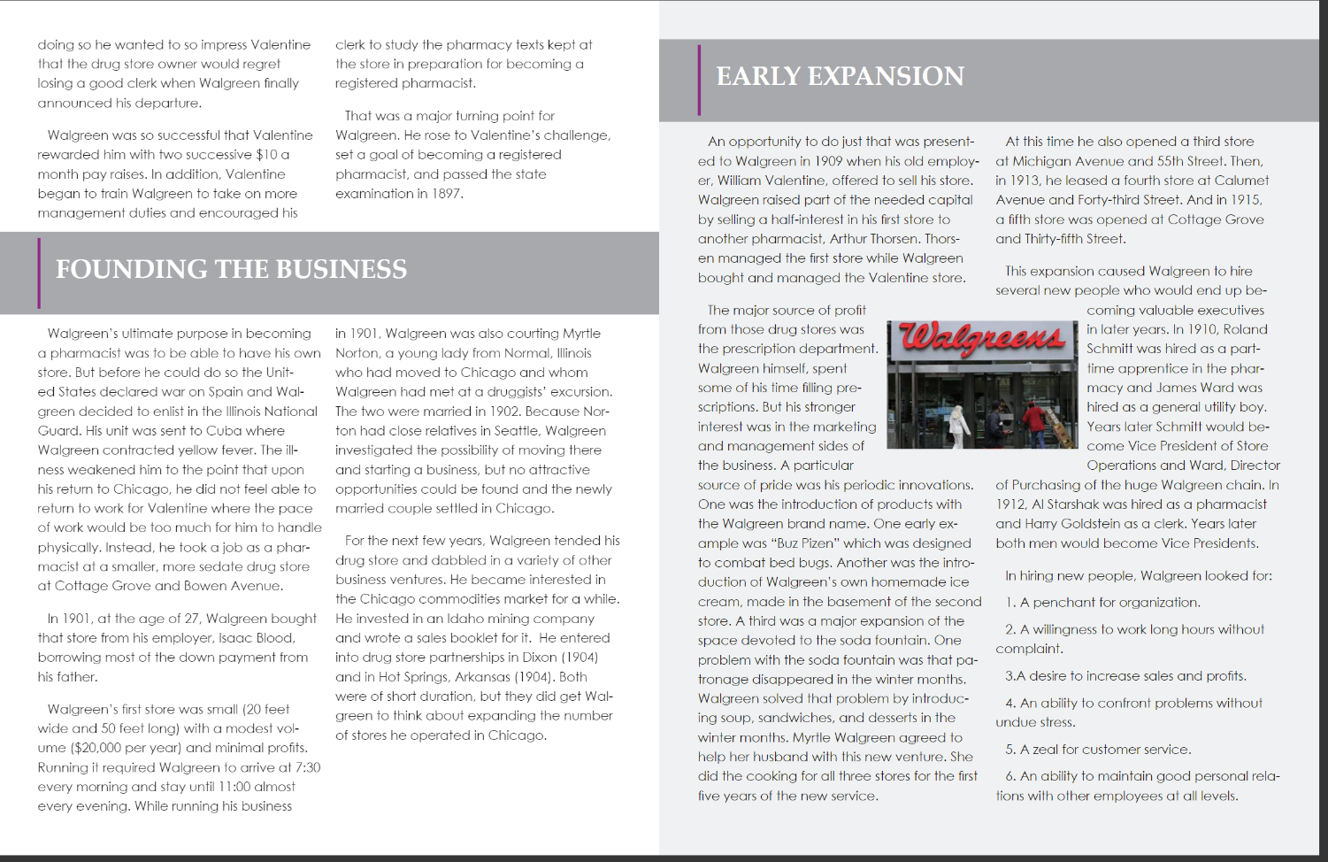

Slide 6
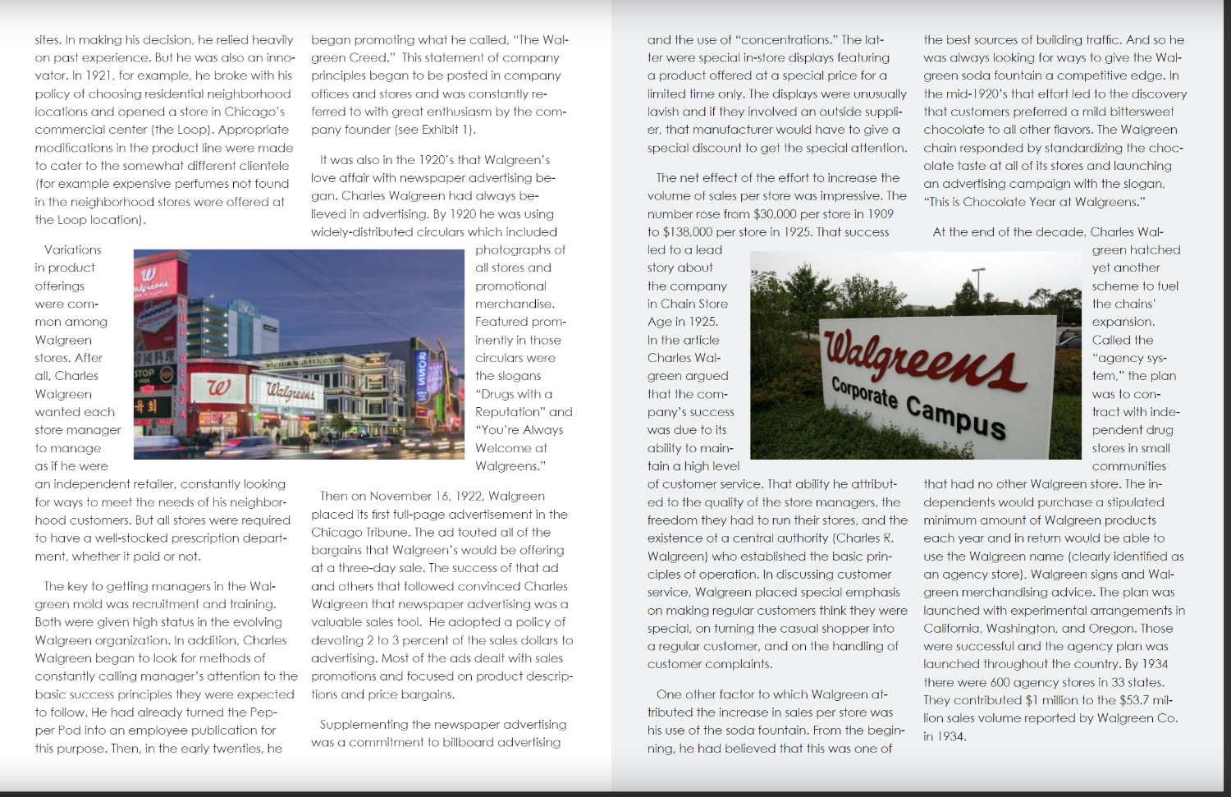

Slide 7
