Slide 1
Cyrus McCormick -- International Harvester
Cyrus McCormick -- International Harvester

Slide 3
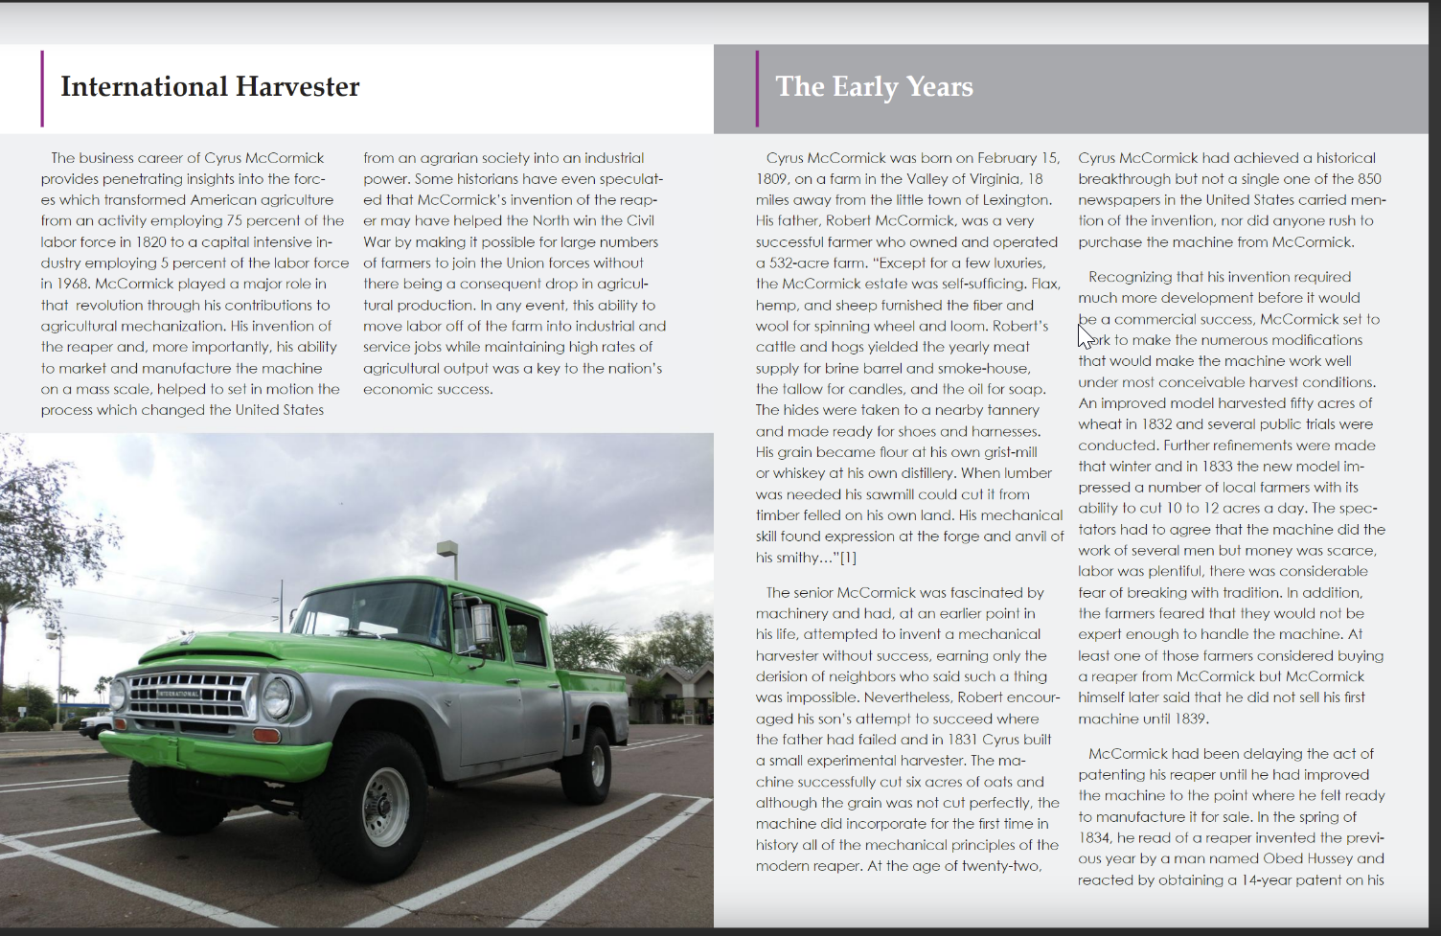

Slide 4
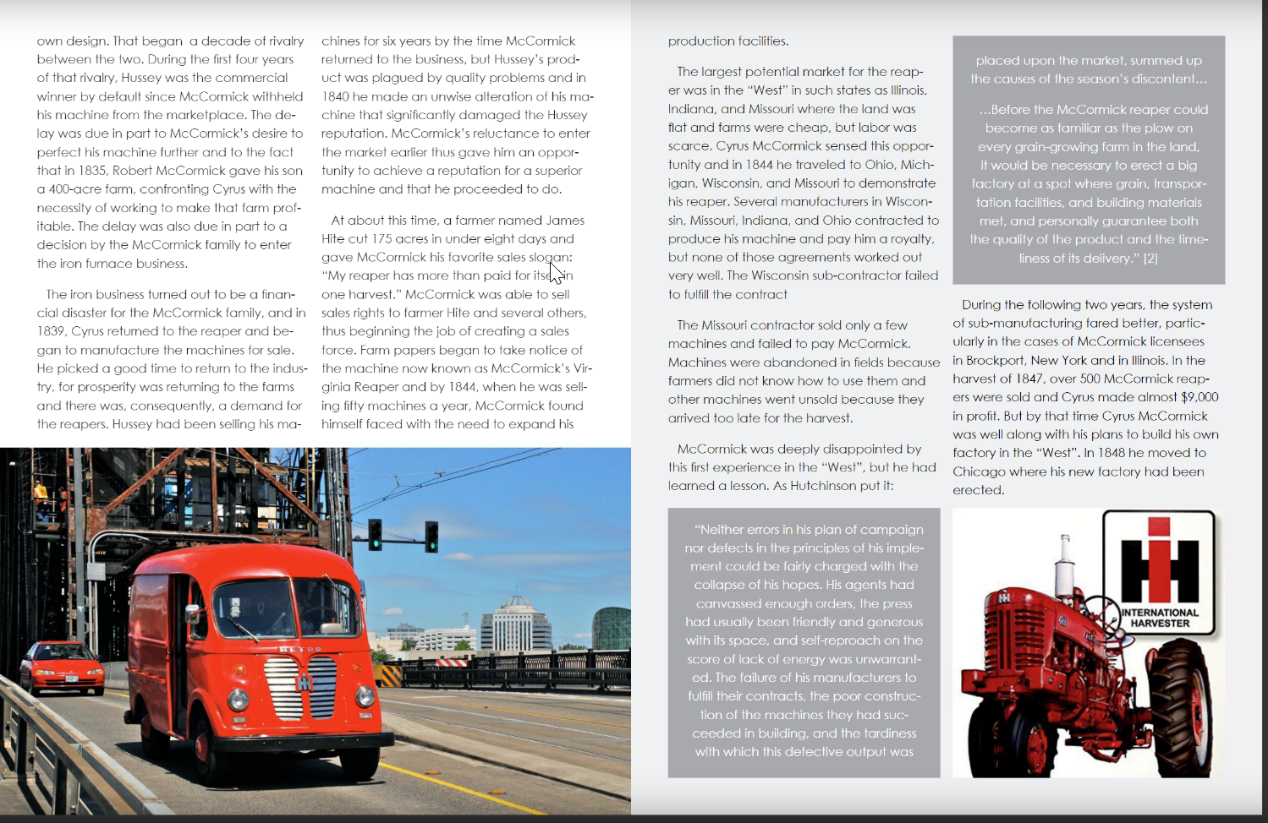

Slide 5
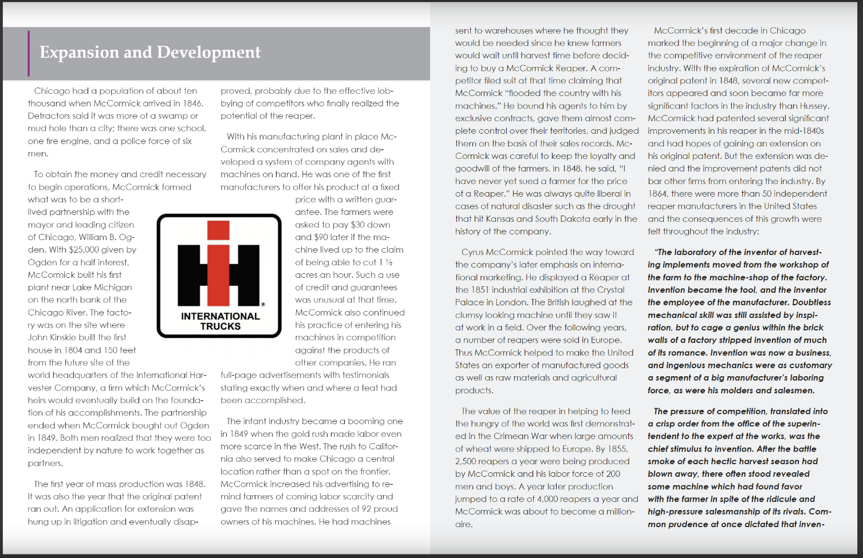

Slide 6
