Slide 1
Charles E. Becker -- Franklin Life Insurance Company
Charles E. Becker -- Franklin Life Insurance Company

Slide 3
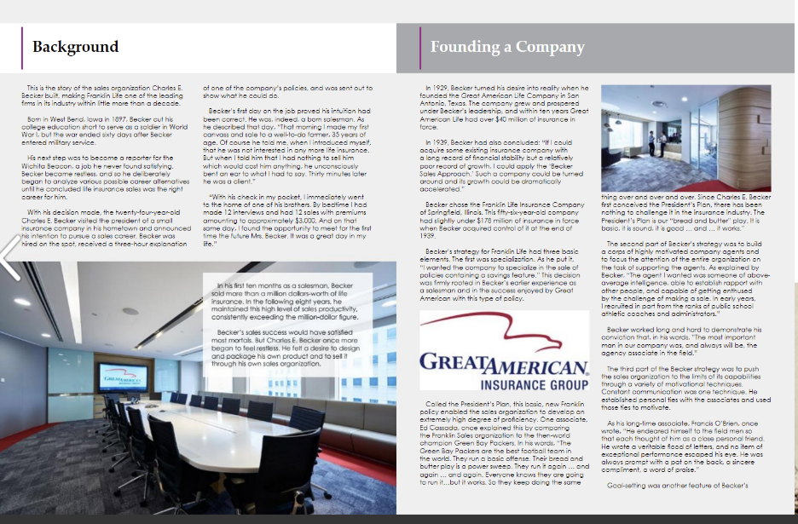

Slide 4
