Slide 1
Aaron Montgomery Ward
Montgomery Ward & Company

Slide 3
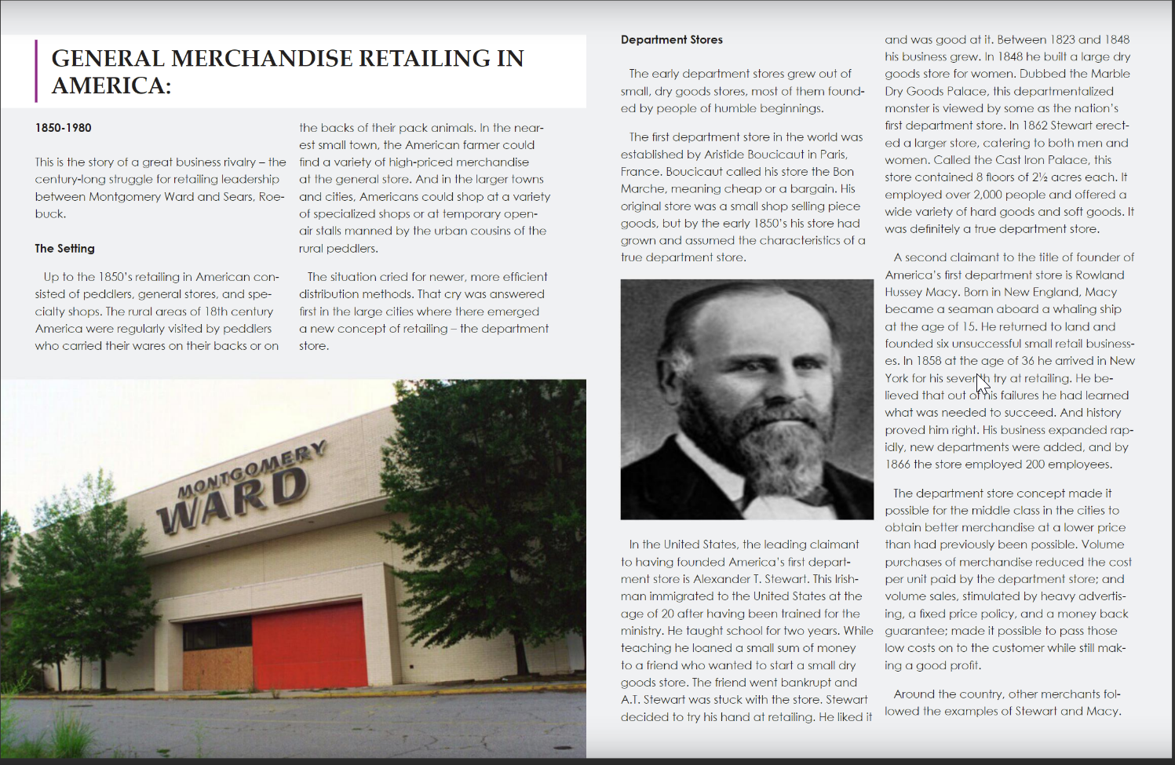

Slide 4
