Slide 1
Andy Granatelli -- STP Corporation
Andy Granatelli -- STP Corporation

Slide 4
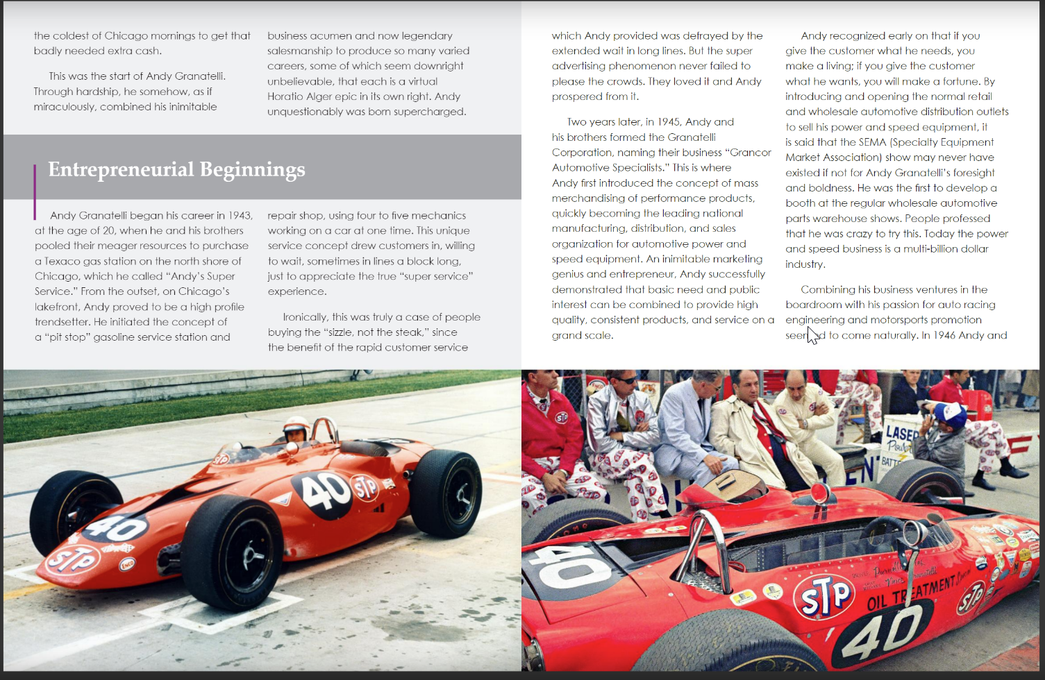

Slide 6
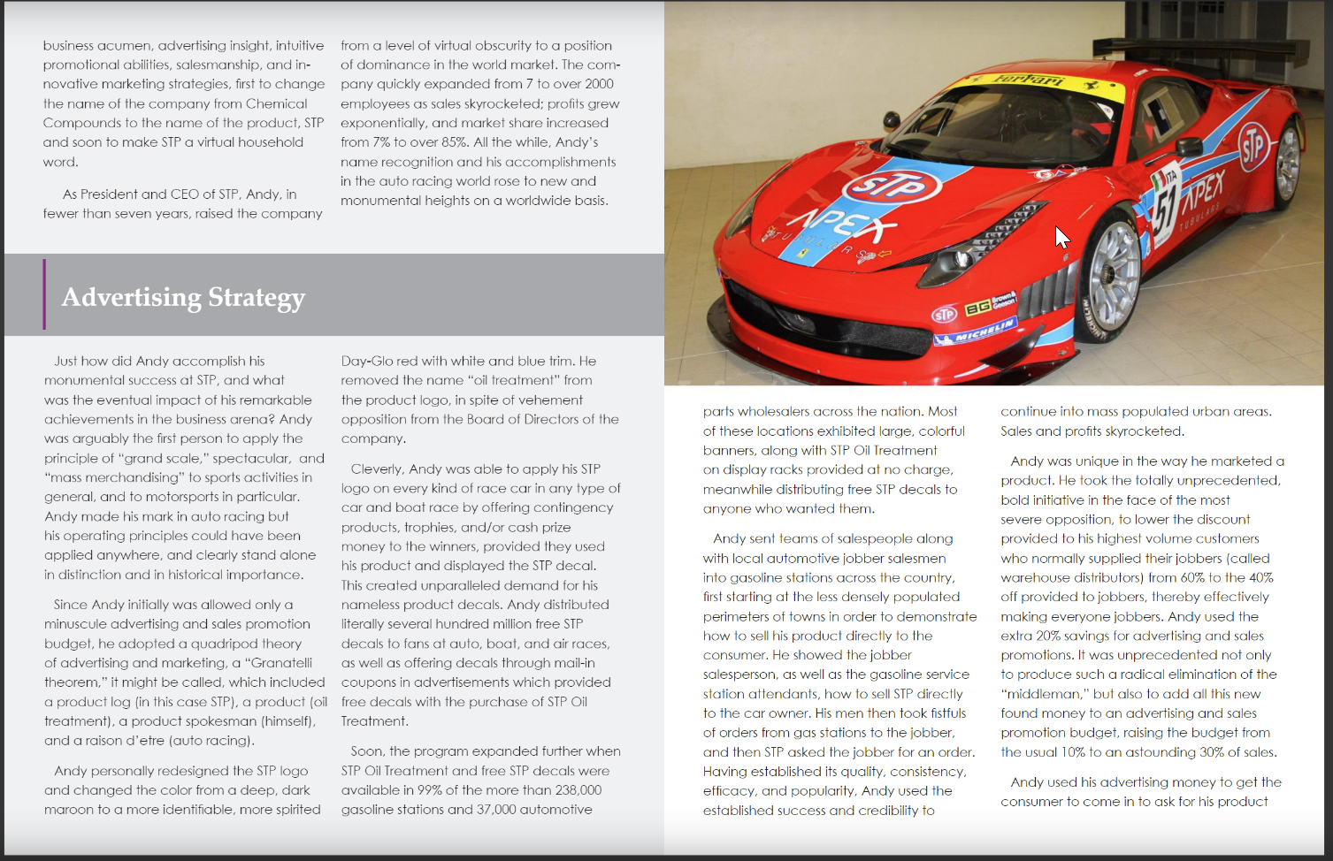

Slide 7
